Slide 1
Prediction of Taxi Fares.
By,
Team 3

Slide 2


What does it take to predict taxi fares ?

Slide 3
Problem Statement :
Predicting the taxi fares based upon the respective inputs

Slide 4
We will discuss about the following.
Problem statement
Introduction
Importing packages
Exploratory Data Analysis
Data Cleaning
Data Analysis
Statistical Models
Linear Regression
Multiple Regression

Slide 5
Introduction:
The taxi fares are not same always and might vary based upon many factors. This unpredictable nature of the taxi fares is the main output here.
In order to study various factors and their effects on the taxi fares many different samples of data were collected. Parameters like payment_type, surcharge, fare_amount e.t.c. are found in the samples thus collected.
This study reveals that the most of the parameters are exceeding their acceptable limit and hence lay significant impact on the taxi fares.

Slide 6
Packages used:
Numpy
Sklearn
Matplotlib
Statsmodel
Pandas
Seaborn

Slide 7
About the packages :
Numpy:-It is a Python package available for performing scientific computations.
Sklearn:-Skearn is a simple tool for data analysis and mining-related tasks.
Matplotlib:-This 2D plotting library of Python is very famous among data scientists for designing varieties of figures in multiple formats which is compatible across their respected platforms.
Statsmodel:-This is responsible for providing the data exploration modules with multiple methods to perform statistical analysis and assertions.
Pandas:-Pandas referred as Python Data Analysis Library and used for availing high-performance data structures and analysis tools.
Seaborn:-Seaborn was designed to visualize the complex statistical models. It has the potential to deliver accurate graphs such as heat maps.

Slide 8
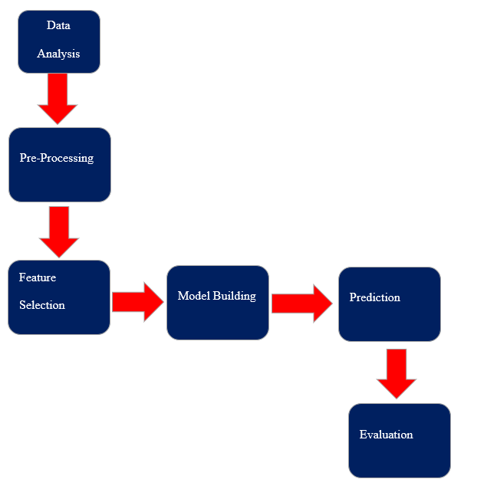
Exploratory Data Analysis:

Slide 9
Exploratory Data Analysis:
Supervised learning.
Total data(labels and features) are in numerical.
Label is numerical , so we can perform following to predict output
1.linear regression
2.stat models.
3.multilinear regression.
For every quartile(Q1,Q2,Q3) the percentage has been increased for each and every feature.
There are no outliers in the data(the diff btwn min and max is too small).
From covariance, Grescore- chance of admit,Toefl score –coa are having strong relationship.
From correlation, all features with label are having good relationship

Slide 10
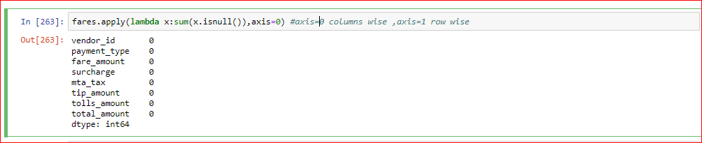
Data Cleaning
In order to perform data cleaning we should use LAMBDA function.
‘Lambda’ is a specialized function which can be used only once to check the missing values. It is a part of anonymous function.

Slide 11
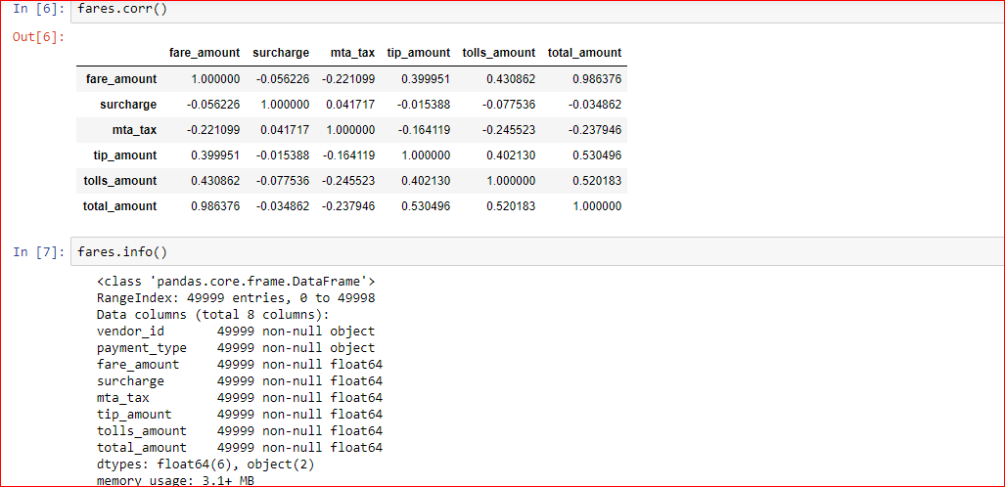
Correlation:
Correlation is a statistical measure that indicates the extent to which two or more variables fluctuate together. A positive correlation indicates the extent to which those variables increase or decrease in parallel; a negative correlation indicates the extent to which one variable increases as the other decreases.

Slide 12
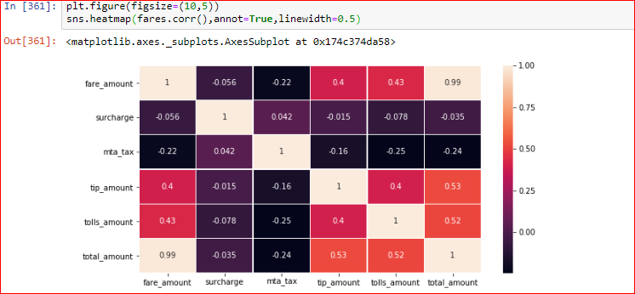
Correlation :Heatmaps
In previous we are using scatter plots to represent the data model heat map is used to represent the data in blocks positive is in whitish colour and negative represents in black colour it also represents all the features in the given data.

Slide 13
Stats model:
r-square : R-squared (R²) is a statistical measure that represents the proportion of the variance for a dependent variable that's explained by an independent variable or variables in a regression model. ... It may also be known as the coefficient of determination.
R2 = 1 – (Residual Square Error)/(Total Square Error)
Rmse: root-mean-square error (RMSE) (or sometimes root-mean-squared error) is a frequently used measure of the differences between values (sample or population values) predicted by a model or an estimator and the values observed. The RMSD represents the square root of the second sample moment of the differences between predicted values and observed values or the quadratic mean of these difference
RMSE = root of sum of squared differences
Correlation: It is the strong relation between two variables Correlation always lies between 0 to 1 weak correlation lies between 0 to 0.5 strong correlation lies between 0.5 to 1
Alpha: It means level of significance
Accuracy: if rmse value is low and R- square value is high then Accuracy is high
Ols: it means ordinary least squares it is used to estimate the un known parameters in the model

Slide 14
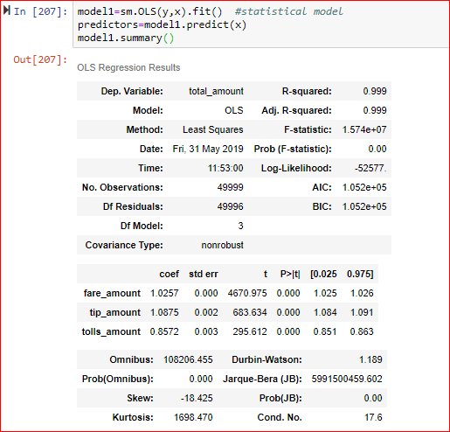
Stats model:
Crownback Constant a.k.a Significance.
If P<α we reject the null hypothesis and accept the alternate hypothesis.
If P>α we accept the null hypothesis and reject the alternate hypothesis.

Slide 15
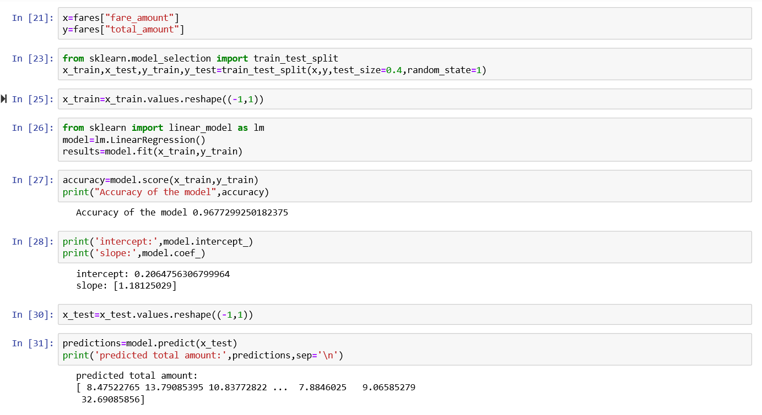
Linear Regression:
Linear regression: It is one of the regression model in linear regression the predicted out put value is in numerical

Slide 16
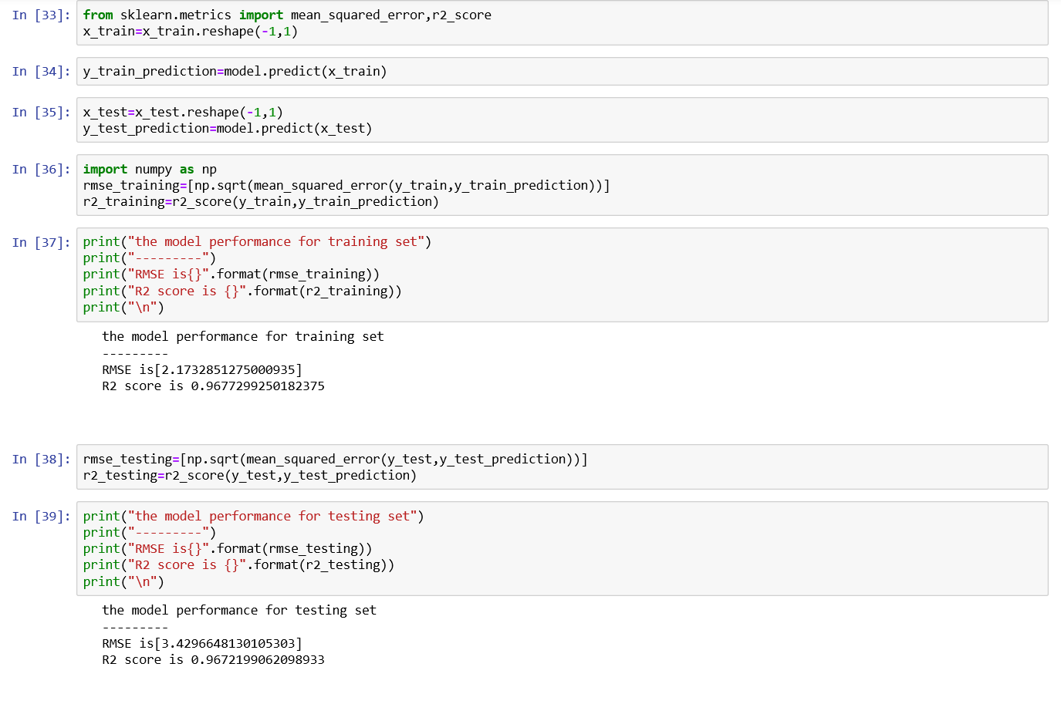
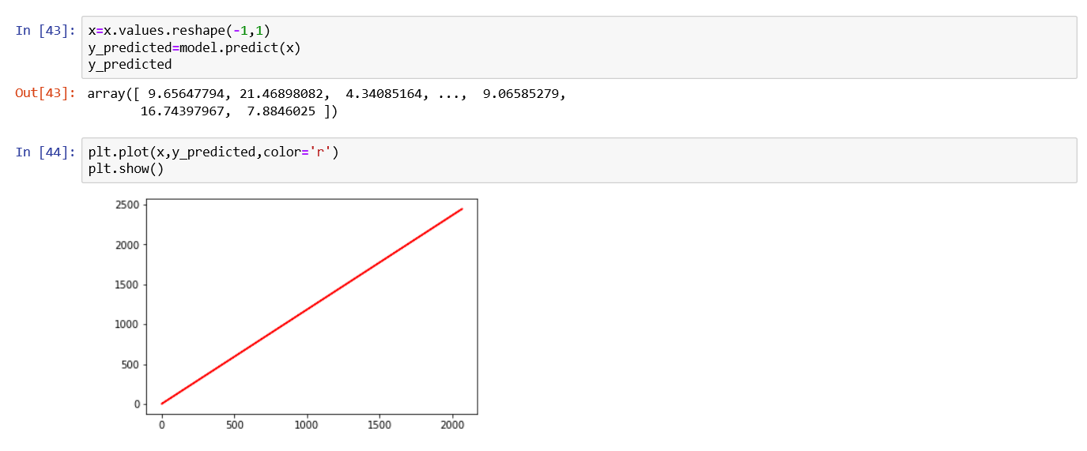
Linear Regression:

Slide 17
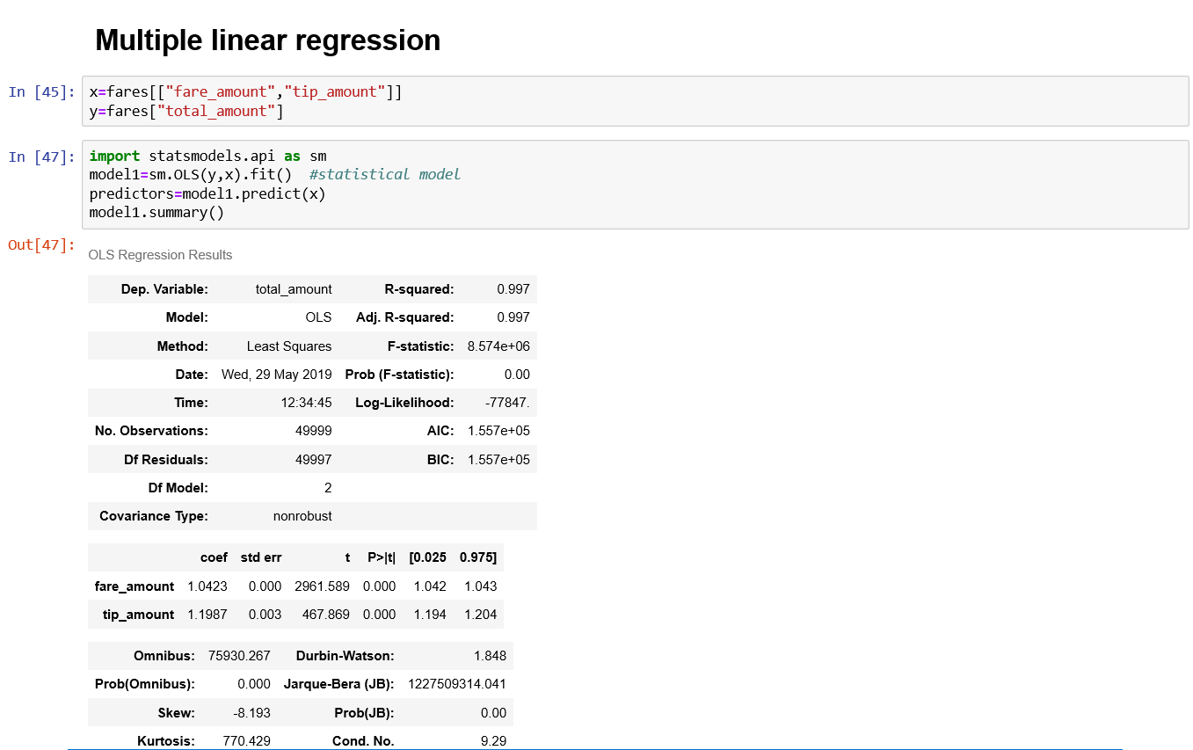
Multiple Regression:
Multiple Linear Regression: it is one of the regression model in multiple linear regression we take one more input values.

Slide 18
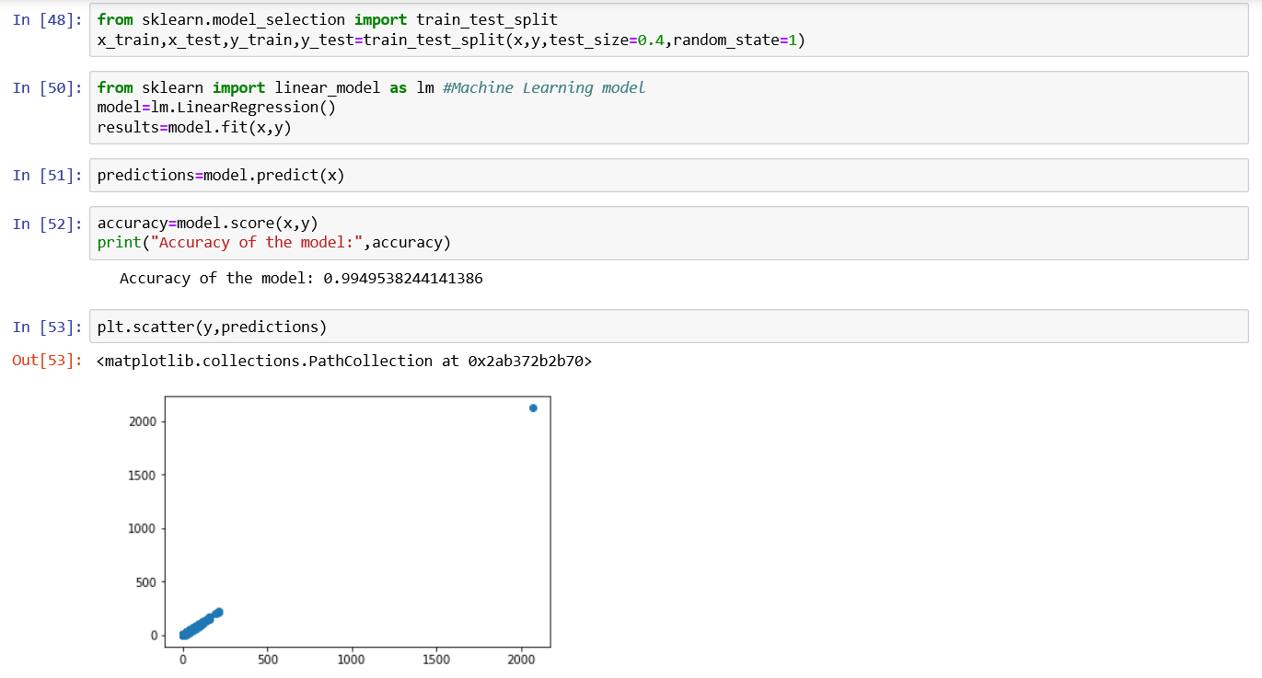
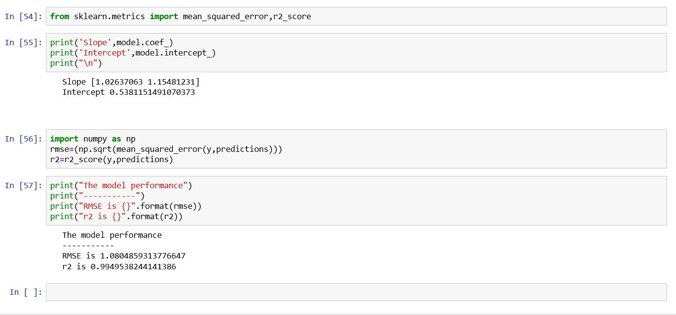
Multiple Regression:

Slide 19
Findings and Suggestions
Through Exploratory Data Analysis, we use linear regression models each were built for data split in 60-40 and partition.
60-40 split
• The Accuracy for single linear regression is 96.2%. It had a R square value for training is 0.967 and RMSE value for training is 2.17.
• The Accuracy for single linear regression is 96.2%. It had a R square value for testing is 0.16 and RMSE value for testing is 3.429
• The Accuracy for multiple linear regression is 99.9
The slope for single linear regression model is 1.1812 and intercept is 0.2064
The slope for multiple linear regression model when we took input variables fare amount toll_amount,tip_amount and intercept is [0.9971,1.007,0.9798] and intercept is 0.8494.

Slide 20
Conclusion:
Of all the linear regression models built usingdifferent data splits, the linear regression model built using 60-40 data split with linear regression model showed comparatively more accuracy, Rsquare, RMSE score
From the above parameters it can be concluded that
Linear and multiple linear regression model with 60-40 data split is a better model to analyze the given data set.
In this project, we have proposed methods for prediction of taxi fares using machine learning techniques. The system was implemented by comparing all other models and their performance was evaluated by using fare and taxes we determined the total charge this model used to reduce burden on taxi drivers.

